Slide 1
Quant Methods for HSR I
Lecture 3: Multivariate OLS Regression
September 27, 2024
HAD5744 • Alex Hoagland, Ph.D.
Notes:
Also ask about project teams and first assignment. Add in the case study here.

Slide 2
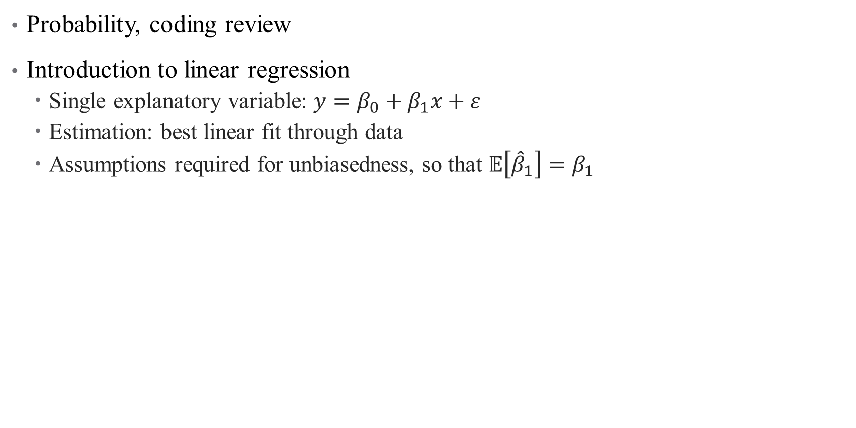
Last time:
Probability, coding review
Introduction to linear regression
Single explanatory variable: $y=β_{0}+β_{1}x+ε$
Estimation: best linear fit through data
Assumptions required for unbiasedness, so that $𝔼\left[{\hat{β}}_{1}\right]=β_{1}$

Slide 3
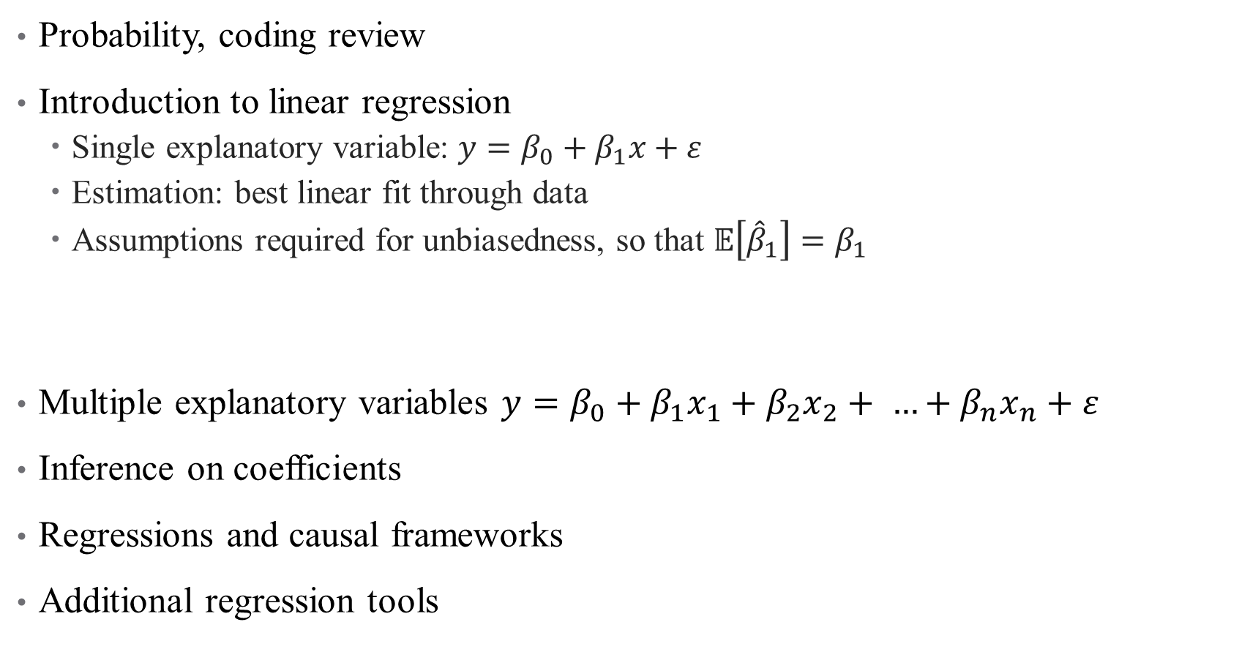
Last time:
Probability, coding review
Introduction to linear regression
Single explanatory variable: $y=β_{0}+β_{1}x+ε$
Estimation: best linear fit through data
Assumptions required for unbiasedness, so that $𝔼\left[{\hat{β}}_{1}\right]=β_{1}$
Multiple explanatory variables $y=β_{0}+β_{1}x_{1}+β_{2}x_{2}+ …+β_{n}x_{n}+ε$
Inference on coefficients
Regressions and causal frameworks
Additional regression tools
This time:
Notes:
What we don’t finish today will be covered next time as well

Slide 4
Multivariate Regression

Slide 5
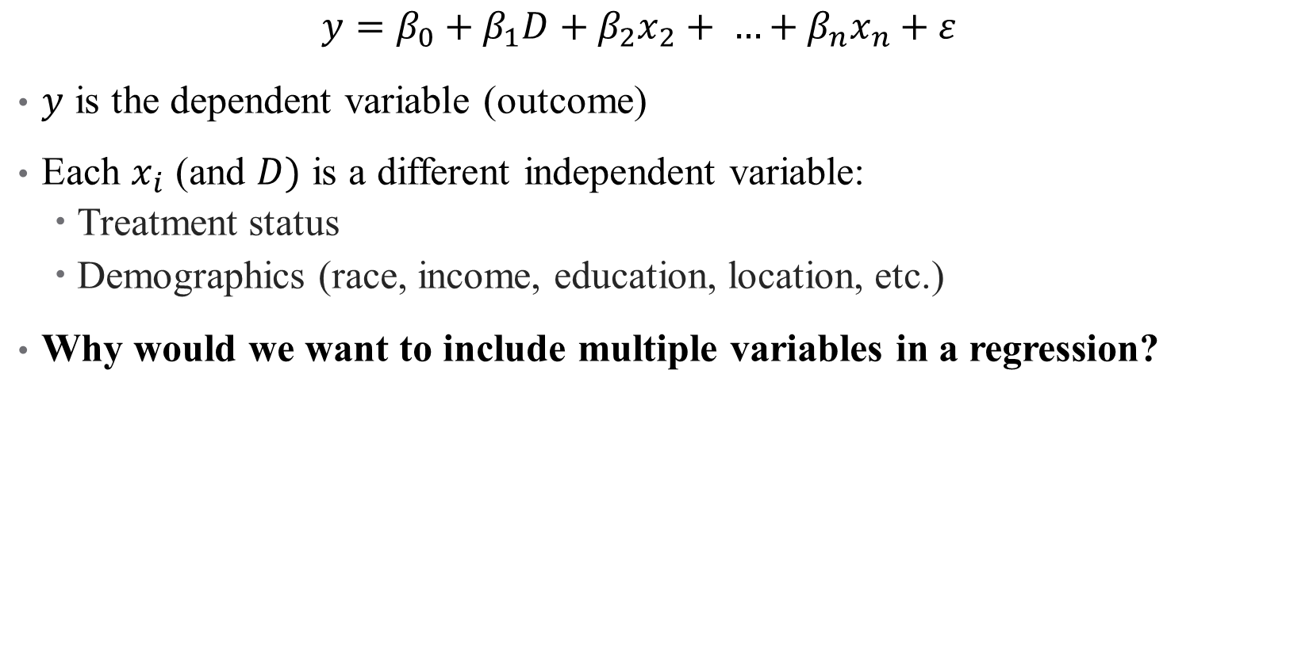
Population Model: Multiple Variables
$$y=β_{0}+β_{1}D+β_{2}x_{2}+ …+β_{n}x_{n}+ε$$
$y$ is the dependent variable (outcome)
Each $x_{i}$ (and $D)$ is a different independent variable:
Treatment status
Demographics (race, income, education, location, etc.)
Why would we want to include multiple variables in a regression?
Notes:
This is not a trick question – think back to our frameworks!

Slide 6
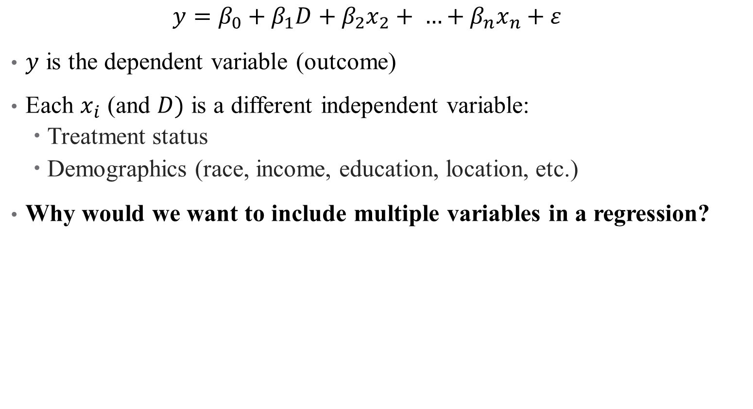
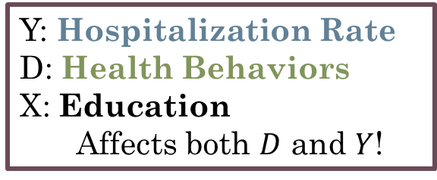
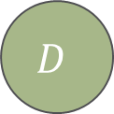

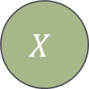
Population Model: Multiple Variables
$$y=β_{0}+β_{1}D+β_{2}x_{2}+ …+β_{n}x_{n}+ε$$
$y$ is the dependent variable (outcome)
Each $x_{i}$ (and $D)$ is a different independent variable:
Treatment status
Demographics (race, income, education, location, etc.)
Why would we want to include multiple variables in a regression?
Y: Hospitalization Rate
D: Health Behaviors
X: Education
Affects both $D$ and $Y$!
$$D$$
$$Y$$
$$X$$

Slide 7
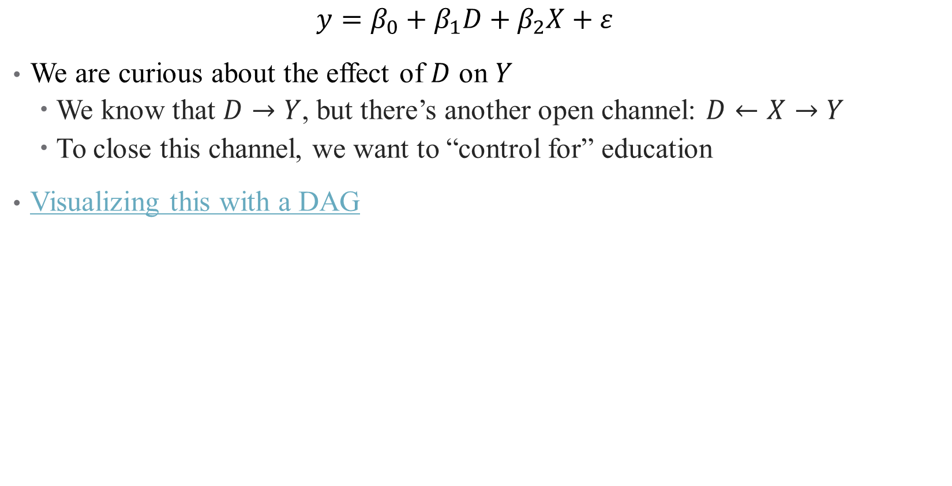
Controlling for Variables
$$y=β_{0}+β_{1}D+β_{2}X+ε$$
We are curious about the effect of $D$ on $Y$
We know that $D→Y$, but there’s another open channel: $D←X→Y$
To close this channel, we want to “control for” education
Visualizing this with a DAG
Notes:
I recommend looking at this site in more detail – we’ll cover the high points here. Videos from Andrew can be opened full screen, talk through when we control for things in a DAG.

Slide 8
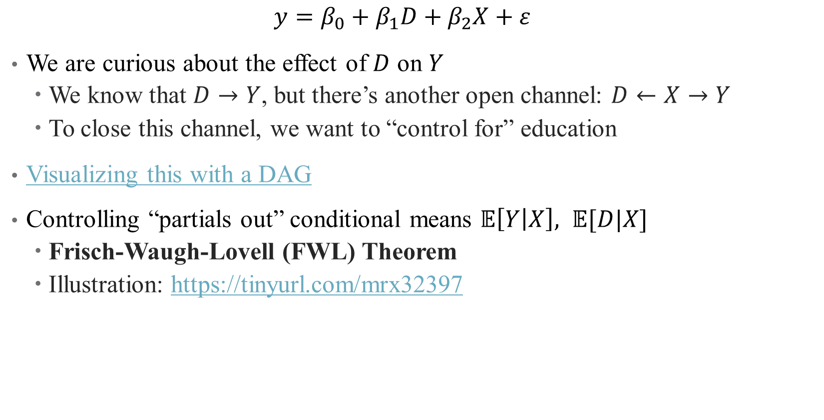
Controlling for Variables
$$y=β_{0}+β_{1}D+β_{2}X+ε$$
We are curious about the effect of $D$ on $Y$
We know that $D→Y$, but there’s another open channel: $D←X→Y$
To close this channel, we want to “control for” education
Visualizing this with a DAG
Controlling “partials out” conditional means $𝔼\left[Y | X\right], 𝔼[D|X]$
Frisch-Waugh-Lovell (FWL) Theorem
Illustration: https://tinyurl.com/mrx32397
Notes:
I recommend looking at this site in more detail – we’ll cover the high points here. Videos from Andrew can be opened full screen, talk through when we control for things in a DAG.

Slide 9
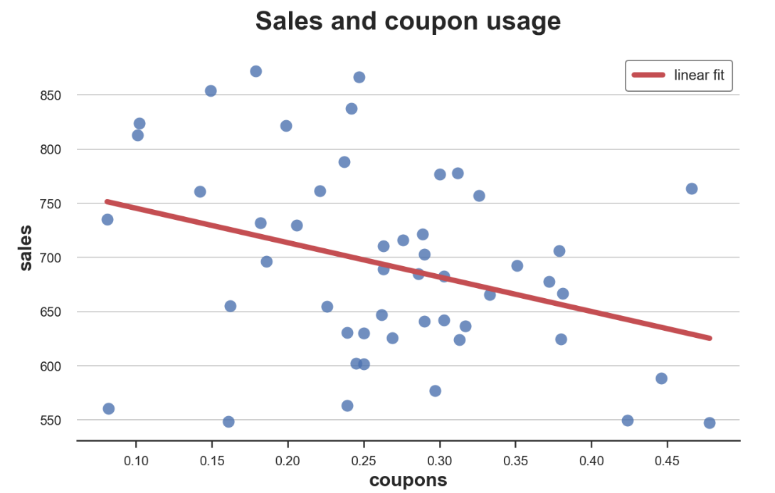
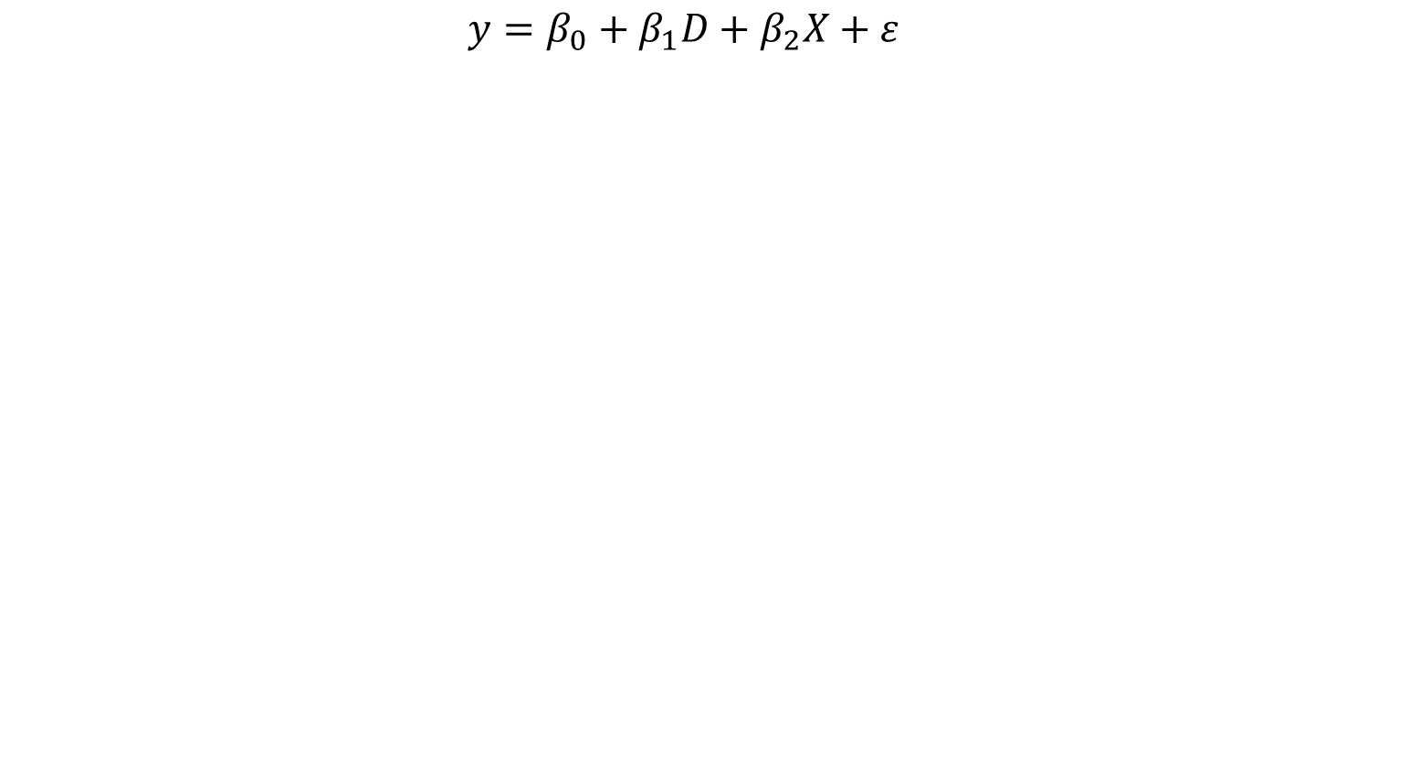
Controlling for Variables
Hospitalizations and Health Behavior (A1C check)
$$y=β_{0}+β_{1}D+β_{2}X+ε$$
Total Annual Diabetes Hospitalizations,
Regional Level
Rate of A1C checks per 1,000 diabetics
Notes:
Note – I’ve “health-ized” the example in the website here. Data here is a local physician’s practice, or health market. What does the line mean? What confounders might we be interested in here?

Slide 10
Controlling for Variables
Hospitalizations and Health Behavior (A1C check)
$$y=β_{0}+β_{1}D+β_{2}X+ε$$
But what about education? What drives health behaviors?
Total Annual Diabetes Hospitalizations,
Regional Level
Rate of A1C checks per 1,000 diabetics

Slide 11
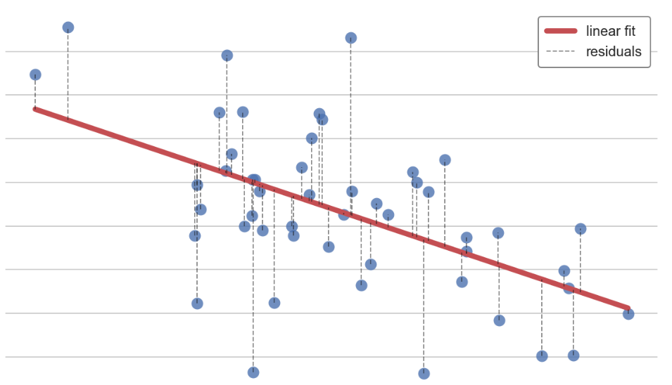
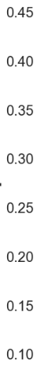
Controlling for Variables: A1Cs and Education
Health Behavior (A1C check) and Education
$$y=β_{0}+β_{1}D+β_{2}X+ε$$
Rate of A1C Checks per 1,000 Diabetics
Average Education in Region
Notes:
Note – there’s a strong relationship here! What does that mean for our initial assessment? We have violated the assumption that E(eps|x)=0 given that we relegated education to epsilon

Slide 12
Controlling for Variables: A1Cs and Education
Health Behavior (A1C check) and Education
$$y=β_{0}+β_{1}D+β_{2}X+ε$$
Rate of A1C Checks per 1,000 Diabetics
Controlling for education removes this linear trend, leaving only the residuals
Average Education in Region
Notes:
We move education out of the error term and correct for this correlation

Slide 13
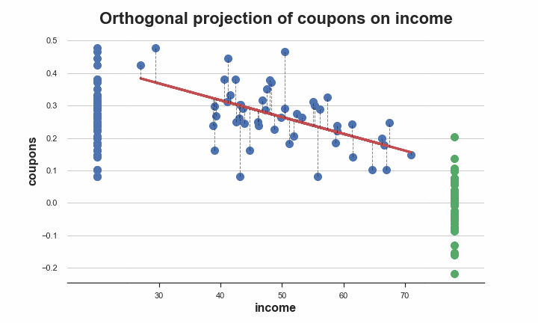
Partialling out Education
Notes:
Ignore the axes here.

Slide 14
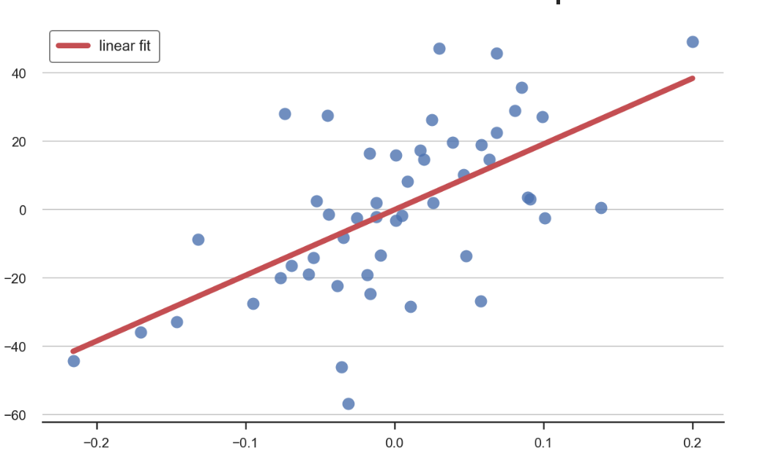

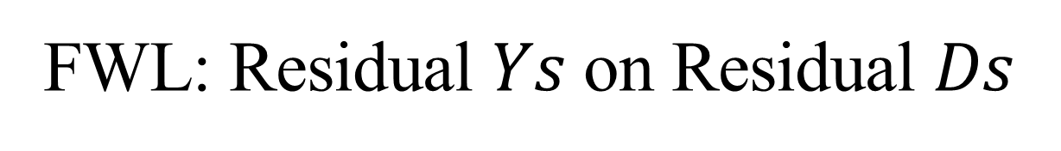
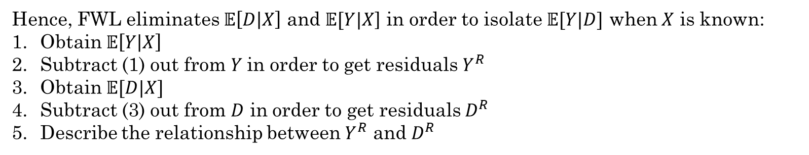
FWL: Residual $Ys$ on Residual $Ds$
Hence, FWL eliminates $𝔼\left[D | X\right]$ and $𝔼[Y|X$] in order to isolate $𝔼[Y|D]$ when $X$ is known:
Obtain $𝔼\left[Y | X\right]$
Subtract (1) out from $Y$in order to get residuals $Y^{R}$
Obtain $𝔼[D|X]$
Subtract (3) out from $D$ in order to get residuals $D^{R}$
Describe the relationship between $Y^{R}$ and $D^{R}$
Hospitalizations and Health Behavior (A1C check)
Residual Hospitalizations
Residual Rate of A1C checks
Notes:
Let’s see how this works in R

Slide 15
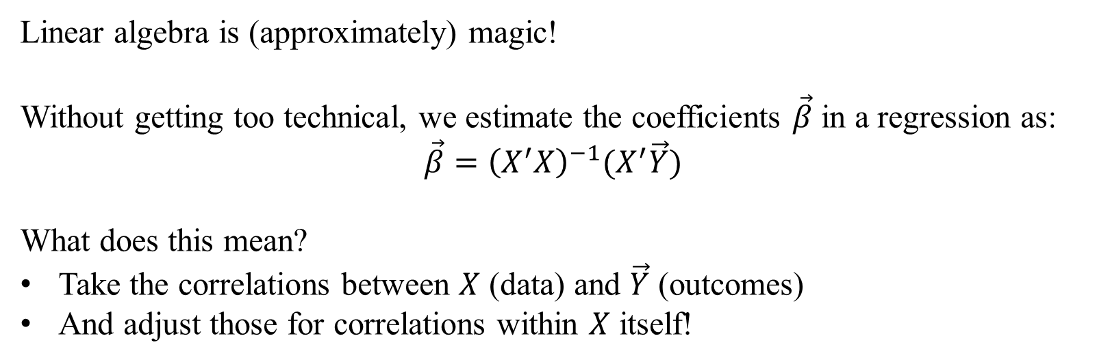
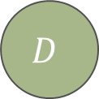

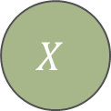
How does multivariate regression work?
Linear algebra is (approximately) magic!
Without getting too technical, we estimate the coefficients $\vec{β}$ in a regression as:
$$\vec{β}={\left(X^{′}X\right)}^{−1}(X^{′}\vec{Y})$$
What does this mean?
Take the correlations between $X$ (data) and $\vec{Y}$ (outcomes)
And adjust those for correlations within $X$ itself!
$$D$$
$$Y$$
$$X$$

Slide 16
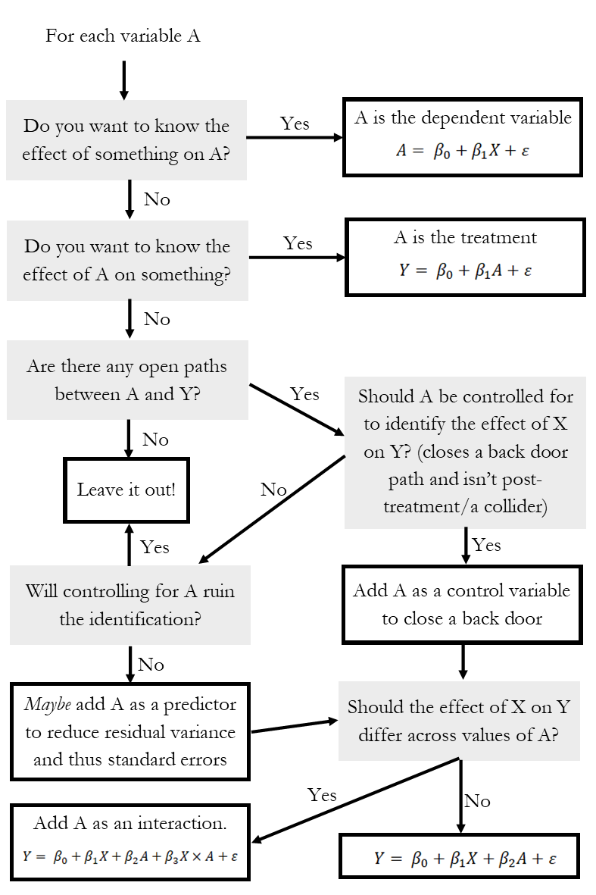
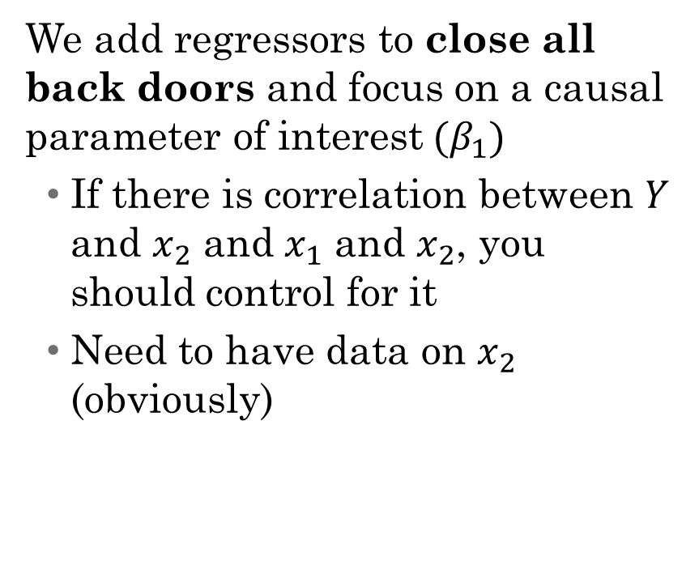
So what do I control for?
We add regressors to close all back doors and focus on a causal parameter of interest$(β_{1})$
If there is correlation between $Y$ and $x_{2}$ and $x_{1}$ and $x_{2}$, you should control for it
Need to have data on $x_{2}$ (obviously)
Notes:
Talk through this – what is a collider/post-treatment (something like controlling for occupation to assess gender wage gap). Think about Andrew’s videos!

Slide 17
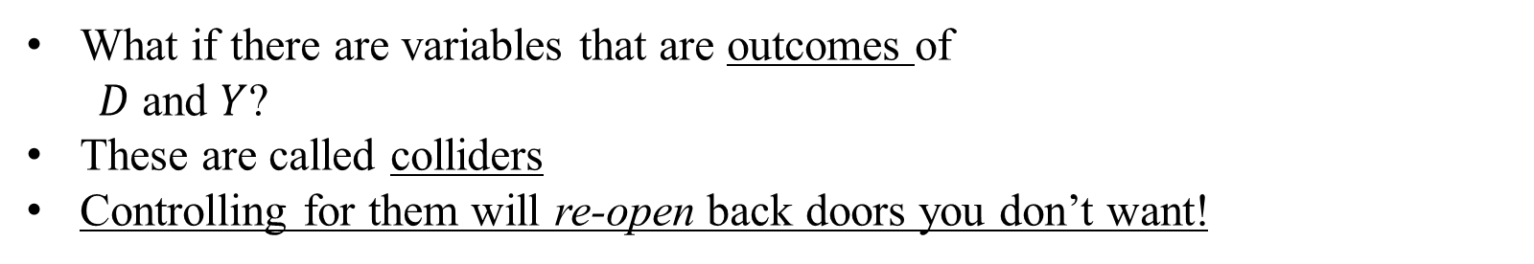



What should you not control for? Colliders
What if there are variables that are outcomes of
$D$ and $Y$?
These are called colliders
Controlling for them will re-open back doors you don’t want!
$$D$$
$$Y$$
$$X$$
Notes:
BP: For example, a person may observe that fast food restaurants which serve good hamburgers tend to serve bad fries and vice versa; but because they would likely not eat anywhere where both were bad, they fail to allow for the large number of restaurants in this category which would weaken or even flip the correlation.
Attrition example: Study comparing 2 Mediterranean diets and a control diet in participants at high cardiovascular risk, cognitive function was improved with both dietary interventions. However, loss to follow-up was higher in the control group (33%) as compared with the Mediterranean diet groups (16% and 23%). Differential loss to follow-up can introduce collider bias because the analysis is restricted to patients who are not lost to follow-up. If participants assigned to one of the Mediterranean diets were less likely to be lost to follow-up than those in the control group and participants with poor cognitive function were independently more likely to be lost to follow-up, restricting the analysis to those not lost to follow-up could result in a spurious or noncausal association between diet and cognitive function.

Slide 18
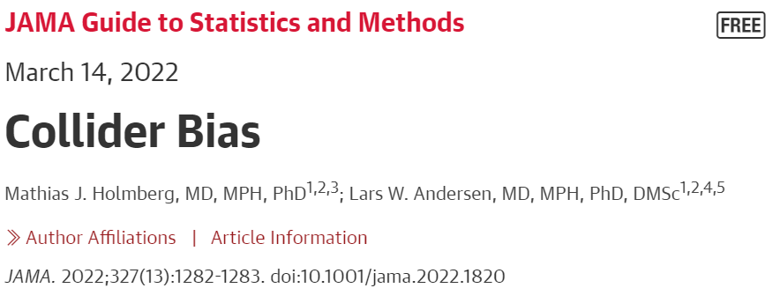
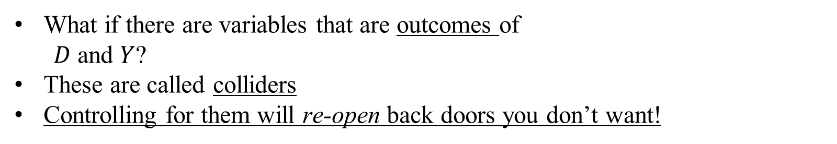
What should you not control for? Colliders
What if there are variables that are outcomes of
$D$ and $Y$?
These are called colliders
Controlling for them will re-open back doors you don’t want!
$$D$$
$$Y$$
$$X$$
Lots of examples of this:
Berkson’s paradox
Sample selection in economics
Differential attrition across groups
Notes:
BP: For example, a person may observe that fast food restaurants which serve good hamburgers tend to serve bad fries and vice versa; but because they would likely not eat anywhere where both were bad, they fail to allow for the large number of restaurants in this category which would weaken or even flip the correlation.
Attrition example: Study comparing 2 Mediterranean diets and a control diet in participants at high cardiovascular risk, cognitive function was improved with both dietary interventions. However, loss to follow-up was higher in the control group (33%) as compared with the Mediterranean diet groups (16% and 23%). Differential loss to follow-up can introduce collider bias because the analysis is restricted to patients who are not lost to follow-up. If participants assigned to one of the Mediterranean diets were less likely to be lost to follow-up than those in the control group and participants with poor cognitive function were independently more likely to be lost to follow-up, restricting the analysis to those not lost to follow-up could result in a spurious or noncausal association between diet and cognitive function.

Slide 19
What should you not control for? Colliders
What if there are variables that are outcomes of
$D$ and $Y$?
These are called colliders
Controlling for them will re-open back doors you don’t want!
$$D$$
$$Y$$
$$X$$
What is the collider bias here?
“In an observational study of 4480 patients with confirmed COVID-19 published in JAMA, Fosbøl et al⁴ found no increase in mortality among patients using angiotensin-converting enzyme inhibitors (ACEIs) or angiotensin receptor blockers (ARBs).
Notes:
Collider bias: The possibility of collider bias should be considered in interpreting this result because the study was restricted to patients with COVID-19, and COVID-19 might represent a collider associated with drug treatment and mortality. – both drug treatment and mortality affect the likelihood of COVID-19. So D is drug treatment and Y is mortality, both of which affect COVID-19 (However, it has been hypothesized that ACEI or ARB use could result in increased susceptibility to COVID-19).

Slide 20
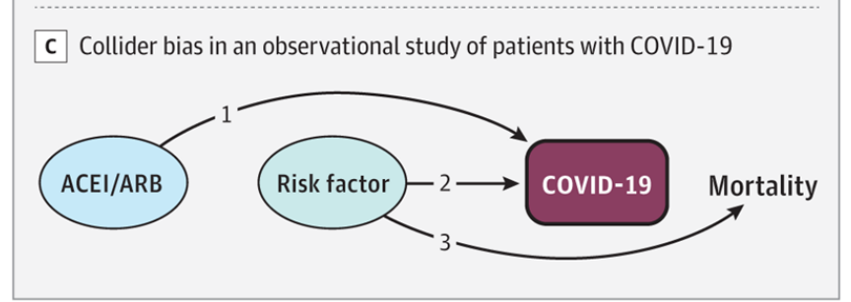
What should you not control for? Colliders
What if there are variables that are outcomes of
$D$ and $Y$?
These are called colliders
Controlling for them will re-open back doors you don’t want!
$$D$$
$$Y$$
$$X$$
What is the collider bias here?
“In an observational study of 4480 patients with confirmed COVID-19 published in JAMA, Fosbøl et al⁴ found no increase in mortality among patients using angiotensin-converting enzyme inhibitors (ACEIs) or angiotensin receptor blockers (ARBs).
Notes:
Collider bias: The possibility of collider bias should be considered in interpreting this result because the study was restricted to patients with COVID-19, and COVID-19 might represent a collider associated with drug treatment and mortality. – both drug treatment and mortality affect the likelihood of COVID-19. So D is drug treatment and Y is mortality, both of which affect COVID-19 (However, it has been hypothesized that ACEI or ARB use could result in increased susceptibility to COVID-19).

Slide 21
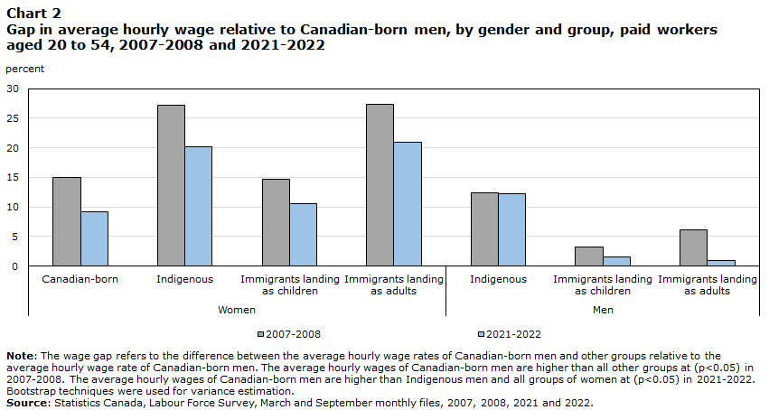
What should you not control for? Selecting on an Outcome
Another very common mistake is when you control for something that occurred after the outcome (this introduces either collider bias or mediator bias)
Notes:
Suppose that we wanted to ascertain the gender wage gap and the impact of discrimination on that gap. You hear things like “59 cents on the dollar,” which has now decreased substantially. But you also hear arguments like “the gap disappears once you adjust for observable characteristics including occupation.” Why is this mediator bias (because gender causes occuptation causes wages – where is the discrimination? Do we want to control for this?)? What can be done about this? (Work by Claudia Goldin, for example, that looks at variation within an occupation but also occupational sorting over time).

Slide 22
Types of Control Variables
Notes:
Break here?

Slide 23

Types of Control Variables: Sliders and Switches
Notes:
Continuous and discrete – we’ll talk about different interpretation of effects here, and more next time. Examples of discrete variables: Racial, ethnic, gender group identification
Years of education, marriage, etc.

Slide 24
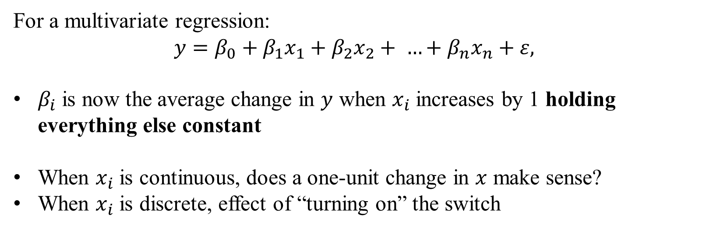
How does interpretation change?
For a multivariate regression:
$$y=β_{0}+β_{1}x_{1}+β_{2}x_{2}+ …+β_{n}x_{n}+ε,$$
$β_{i}$ is now the average change in $y$ when $x_{i}$ increases by 1 holding everything else constant
When $x_{i}$ is continuous, does a one-unit change in $x$ make sense?
When $x_{i}$ is discrete, effect of “turning on” the switch
Notes:
Interpretation now relies on holding everything else in the regression constant – if this doesn’t work for what you want to know, need to rethink the design of the regression (e.g., interactions). Also think about causality in the context of FWL – we aren’t identifying causal pathways, we’re closing back doors! (This is model-based inference at its best, the whole regression focuses on one pathway in the DAG that you want).

Slide 25
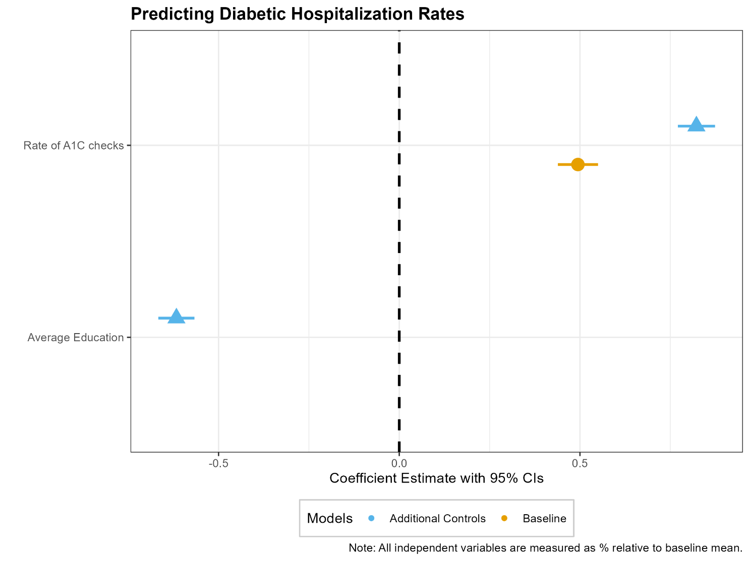
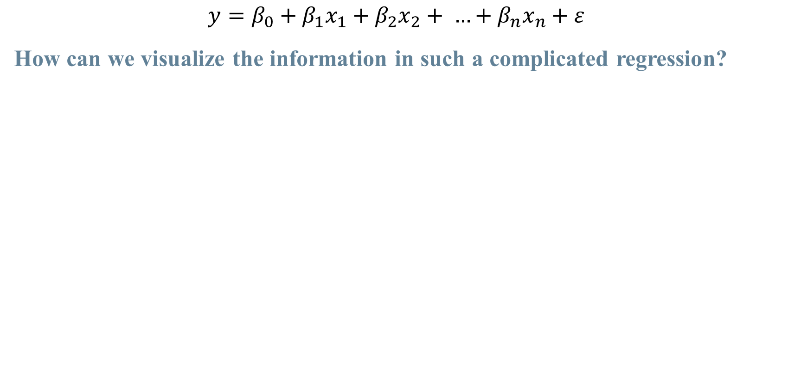
Estimating and Visualizing our Regressions
$$y=β_{0}+β_{1}x_{1}+β_{2}x_{2}+ …+β_{n}x_{n}+ε$$
How can we visualize the information in such a complicated regression?

Slide 26
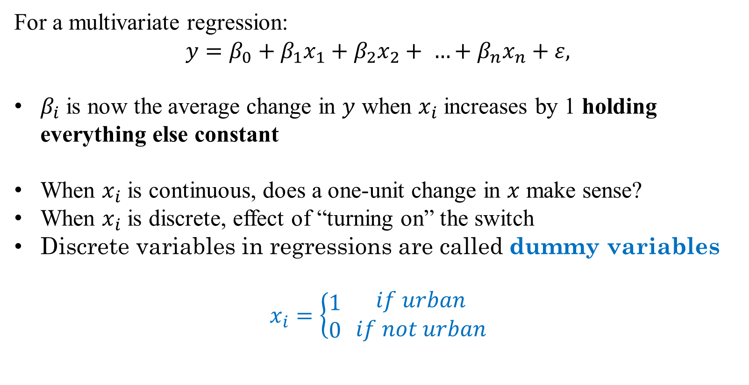
How does interpretation change?
For a multivariate regression:
$$y=β_{0}+β_{1}x_{1}+β_{2}x_{2}+ …+β_{n}x_{n}+ε,$$
$β_{i}$ is now the average change in $y$ when $x_{i}$ increases by 1 holding everything else constant
When $x_{i}$ is continuous, does a one-unit change in $x$ make sense?
When $x_{i}$ is discrete, effect of “turning on” the switch
Discrete variables in regressions are called dummy variables
$$x_{i}=\left\{\begin{aligned}1 \\ 0\end{aligned} \right.\begin{matrix}if urban \\ if not urban\end{matrix}$$

Slide 27
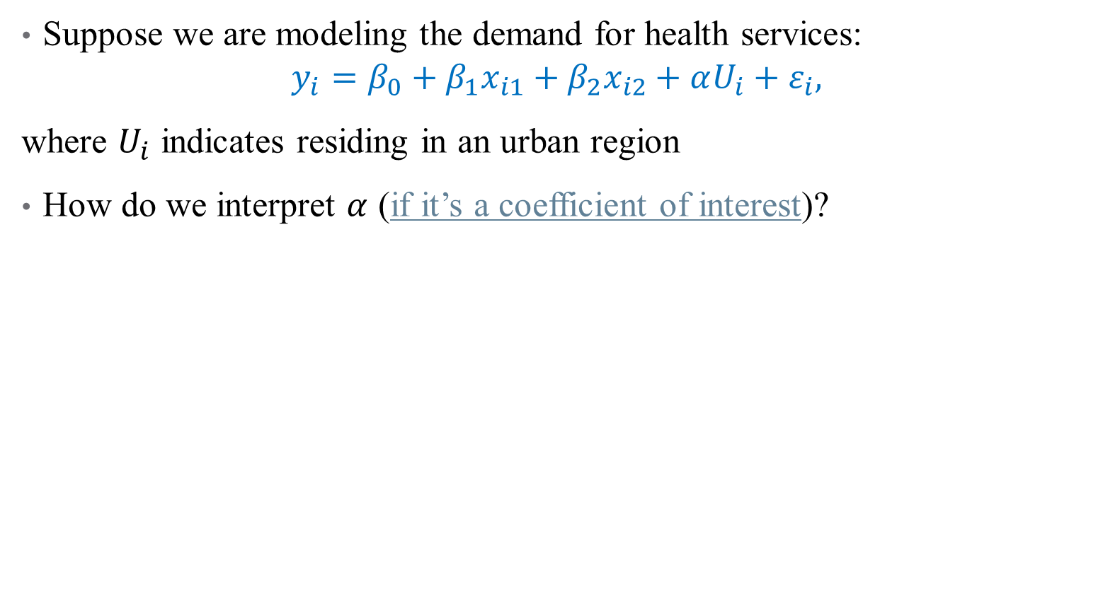
Discrete Regressors
Suppose we are modeling the demand for health services:
$$y_{i}=β_{0}+β_{1}x_{i1}+β_{2}x_{i2}+αU_{i}+ε_{i},$$
where $U_{i}$ indicates residing in an urban region
How do we interpret $α$ (if it’s a coefficient of interest)?
Notes:
Talk about subscripts here

Slide 28
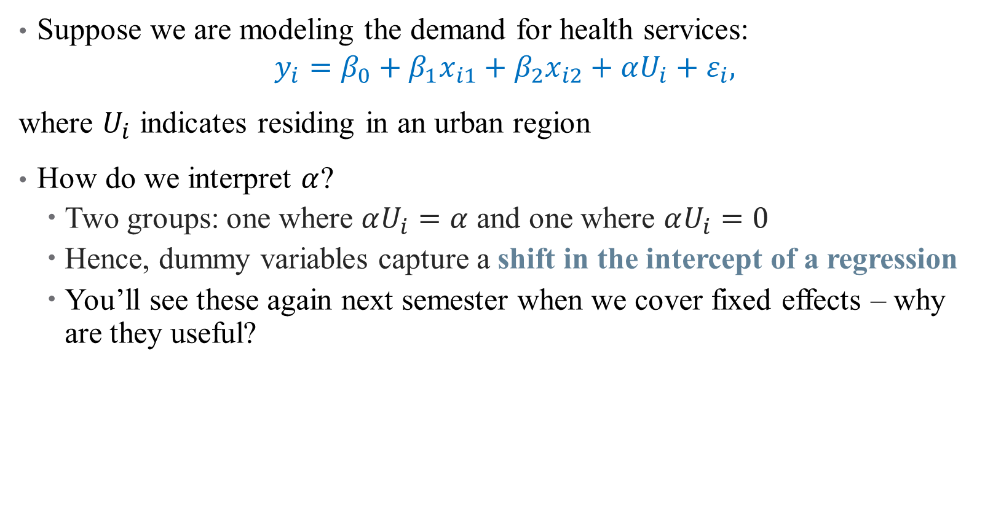
Discrete Regressors
Suppose we are modeling the demand for health services:
$$y_{i}=β_{0}+β_{1}x_{i1}+β_{2}x_{i2}+αU_{i}+ε_{i},$$
where $U_{i}$ indicates residing in an urban region
How do we interpret $α$?
Two groups: one where $αU_{i}=α$ and one where $αU_{i}=0$
Hence, dummy variables capture a shift in the intercept of a regression
You’ll see these again next semester when we cover fixed effects – why are they useful?
Notes:
Talk about subscripts here. Useful because they capture differences across groups (with high-frequency panel data, can consider using these in a more granular way, that’s what a FE is)

Slide 29
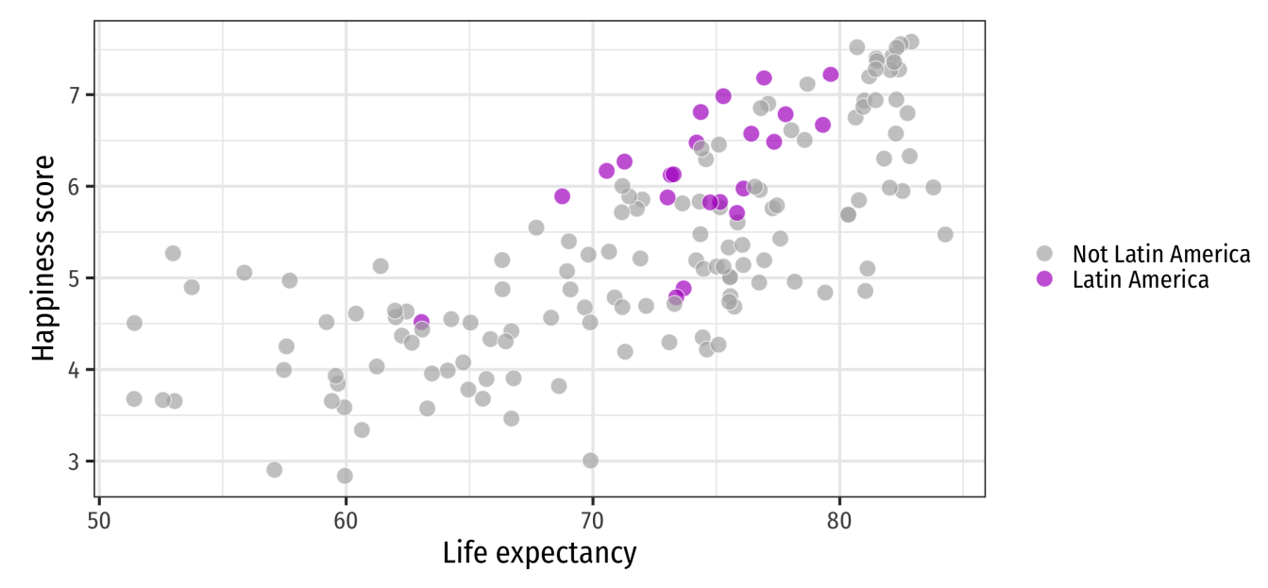
Discrete Regressors

Slide 30
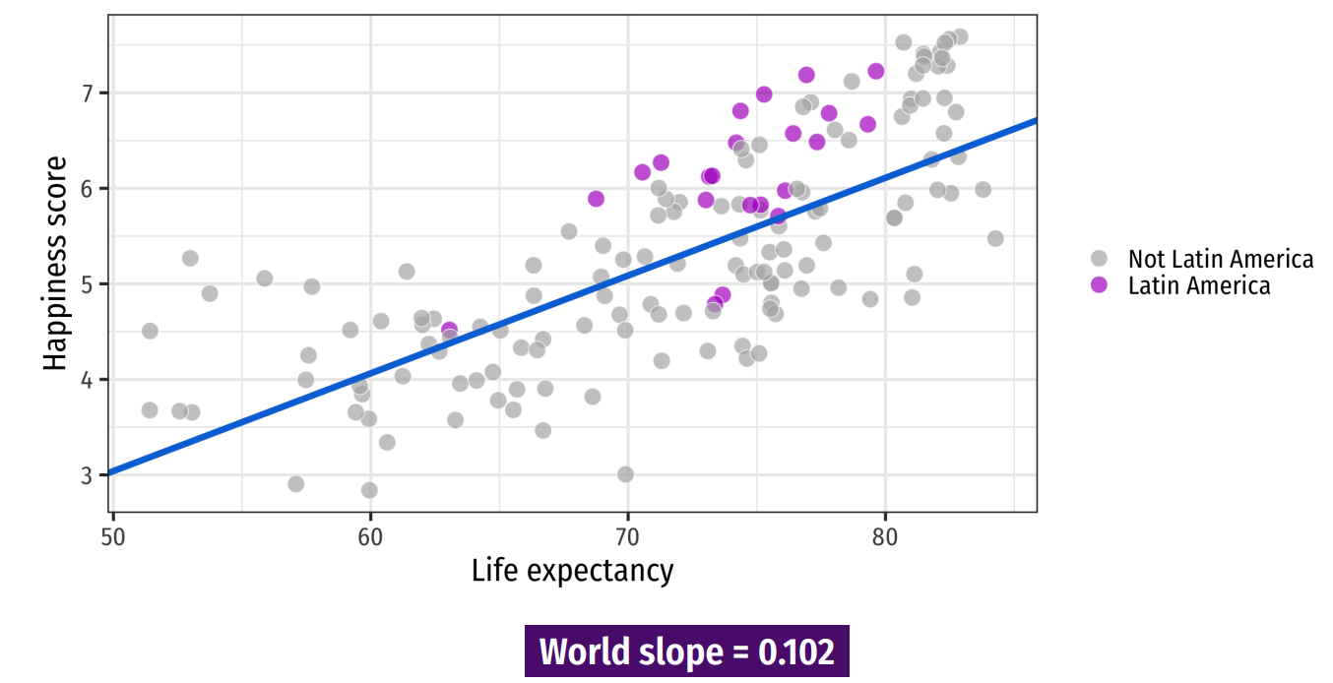
Discrete Regressors
Notes:
Here’s the world slope – does it seem to go through the points for Latin America? No! If we were to run a separate regression just on those points we’d get a different intercept.

Slide 31
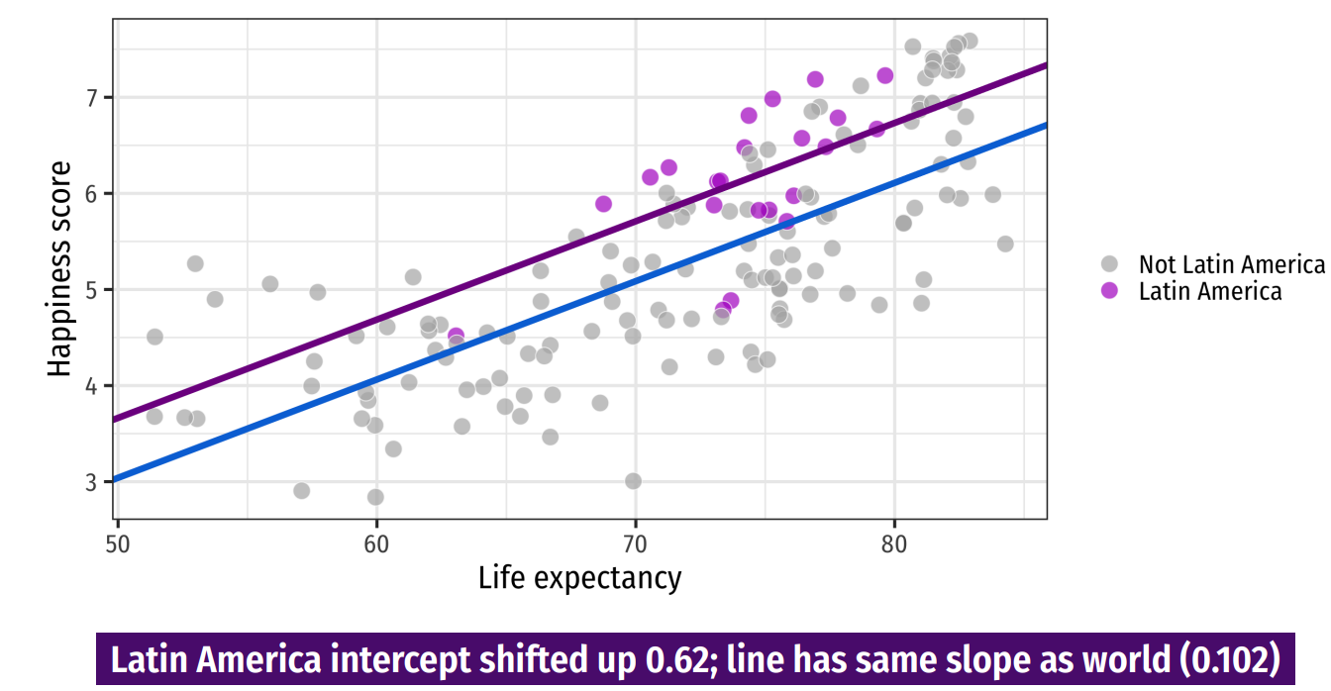
Discrete Regressors
Notes:
So add a dummy intercept! What’s the interpretation? Next time – talk about if we want the slope to vary across groups

Slide 32
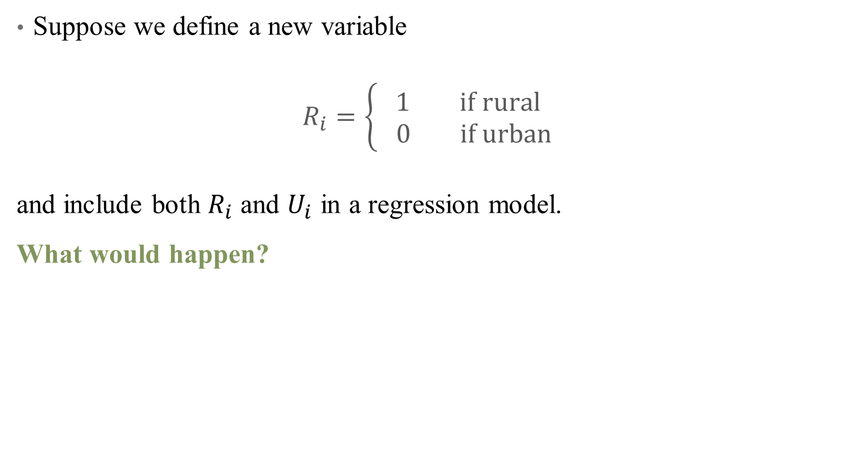
The Dummy Variable Trap
Suppose we define a new variable
$R_{i}=\left\{\begin{aligned}1 if rural \\ 0 if urban \end{aligned}\right.$
and include both $R_{i}$ and $U_{i}$ in a regression model.
What would happen?
Notes:
Perfect Multicolinearity = multiple solutions (if true coefficient is +5 for urban, then could be +7, -2, or -10-,-15, etc.)

Slide 33
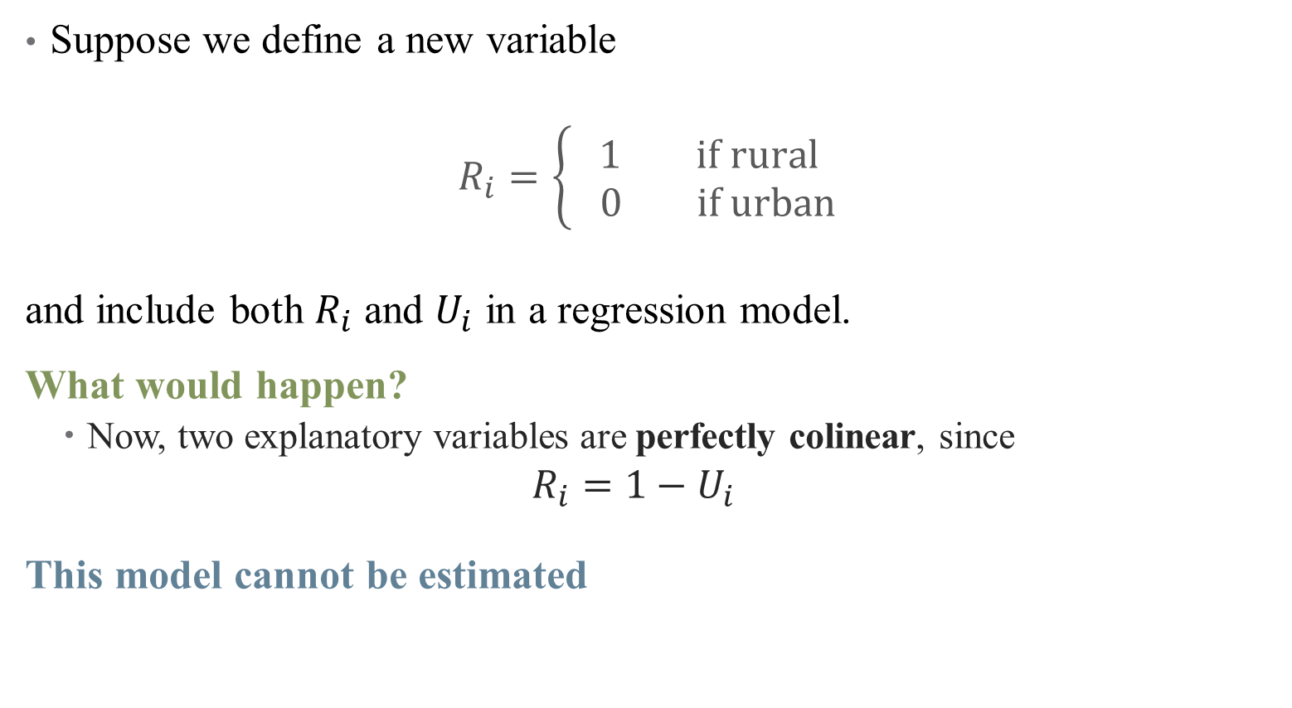
The Dummy Variable Trap
Suppose we define a new variable
$R_{i}=\left\{\begin{aligned}1 if rural \\ 0 if urban \end{aligned}\right.$
and include both $R_{i}$ and $U_{i}$ in a regression model.
What would happen?
Now, two explanatory variables are perfectly colinear, since
$$R_{i}=1−U_{i}$$
This model cannot be estimated
Notes:
Perfect Multicolinearity = multiple solutions (if true coefficient is +5 for urban, then could be +7, -2, or -10-,-15, etc.)

Slide 34
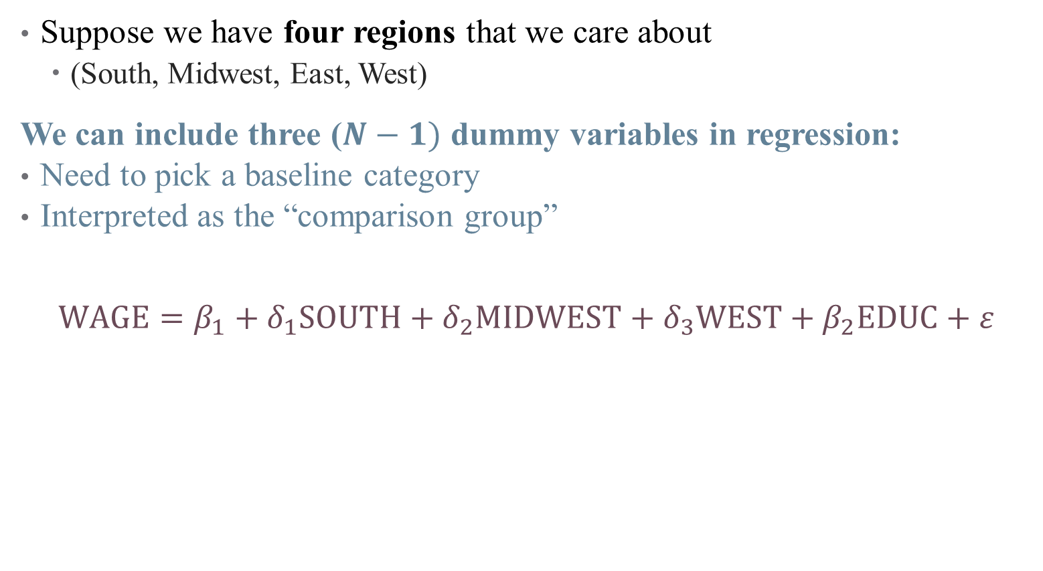
Avoiding the Dummy Variable Trap
Suppose we have four regions that we care about
(South, Midwest, East, West)
We can include three ($N−1)$ dummy variables in regression:
Need to pick a baseline category
Interpreted as the “comparison group”
$$WAGE=β_{1}+δ_{1}SOUTH+δ_{2}MIDWEST+δ_{3}WEST+β_{2}EDUC+ε$$
Notes:
Talk about subscripts here

Slide 35
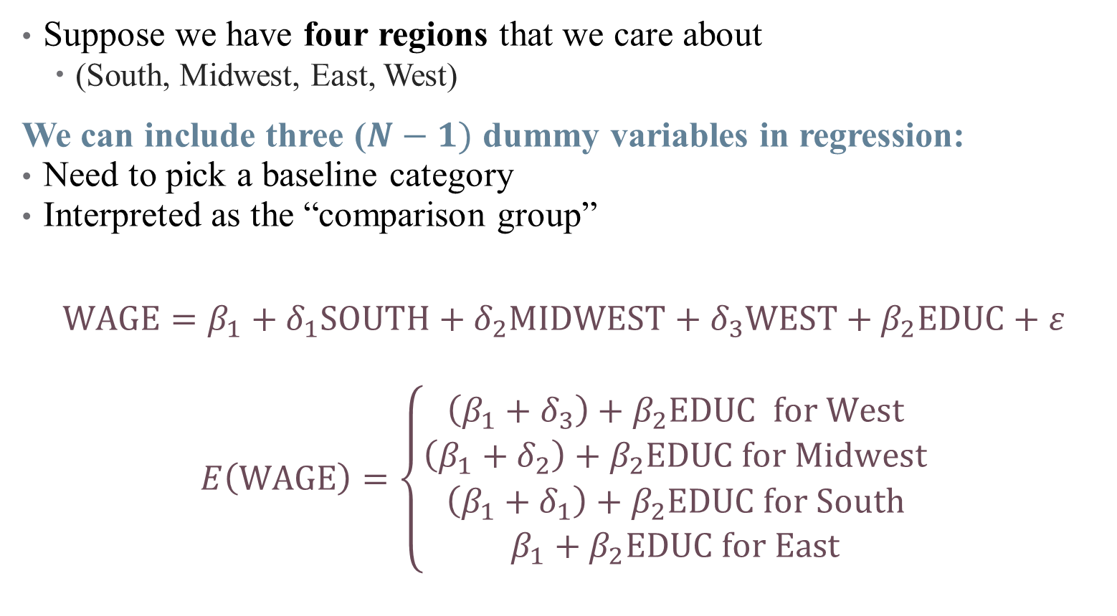
Avoiding the Dummy Variable Trap
Suppose we have four regions that we care about
(South, Midwest, East, West)
We can include three ($N−1)$ dummy variables in regression:
Need to pick a baseline category
Interpreted as the “comparison group”
$$WAGE=β_{1}+δ_{1}SOUTH+δ_{2}MIDWEST+δ_{3}WEST+β_{2}EDUC+ε$$
$$E\left(WAGE\right)=\left\{\begin{aligned}\left(β_{1}+δ_{3}\right)+β_{2}EDUC for West \\ \left(β_{1}+δ_{2}\right)+β_{2}EDUC for Midwest \\ \left(β_{1}+δ_{1}\right)+β_{2}EDUC for South \\ β_{1}+β_{2}EDUC for East\end{aligned}\right.$$
Notes:
Interpretation – start from bottom with “reference category”

Slide 36
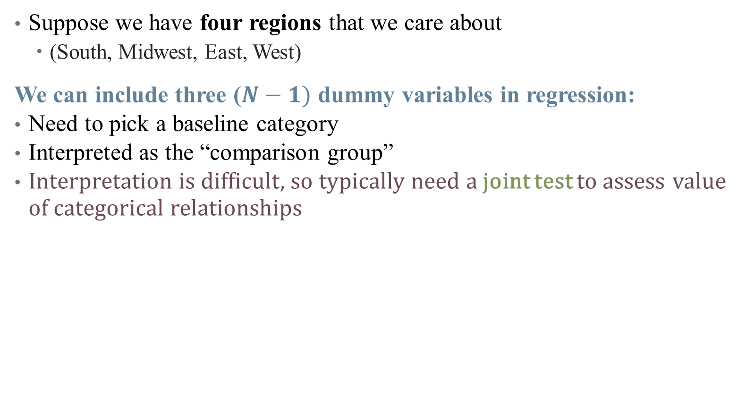
Avoiding the Dummy Variable Trap
Suppose we have four regions that we care about
(South, Midwest, East, West)
We can include three ($N−1)$ dummy variables in regression:
Need to pick a baseline category
Interpreted as the “comparison group”
Interpretation is difficult, so typically need a joint test to assess value of categorical relationships
Notes:
We’re about to talk about significance in next section, so we can return to this.

Slide 37
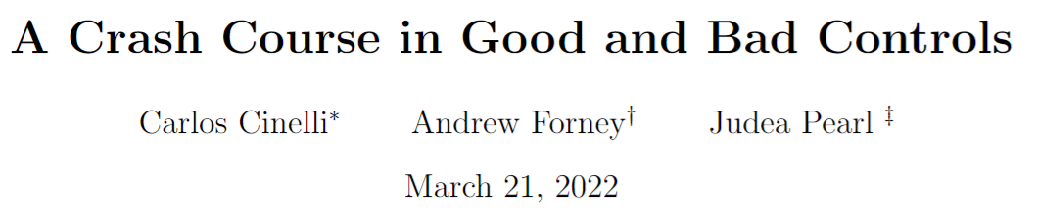
So What do I Control For (again?)
If you are doing model-based inference, your choice of controls really matters!
Notes:
Skip through these examples (but recommend the paper). Go to the crash course below.

Slide 38
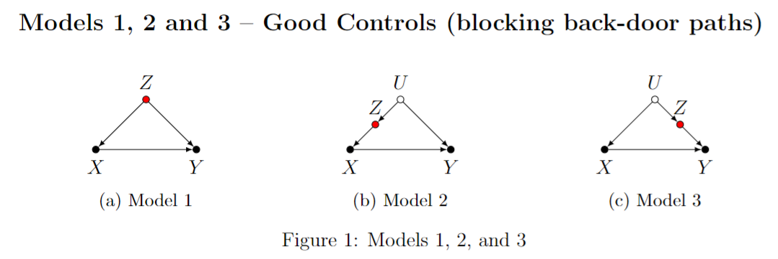
So What do I Control For (again?)
If you are doing model-based inference, your choice of controls really matters!
Notes:
What are some examples here?

Slide 39
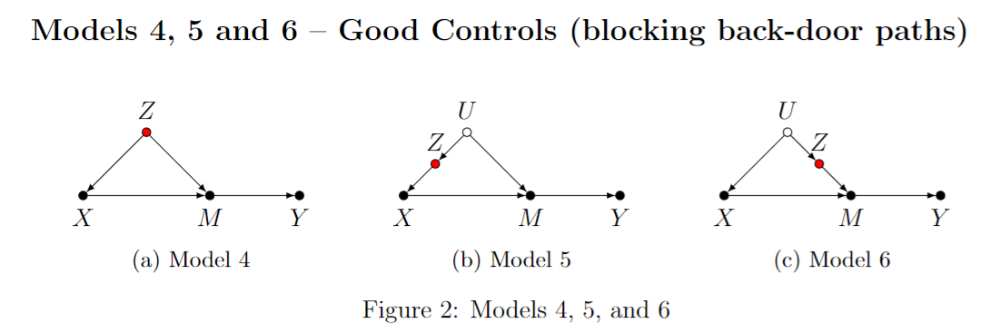
So What do I Control For (again?)
If you are doing model-based inference, your choice of controls really matters!
Notes:
What are some examples here?

Slide 40
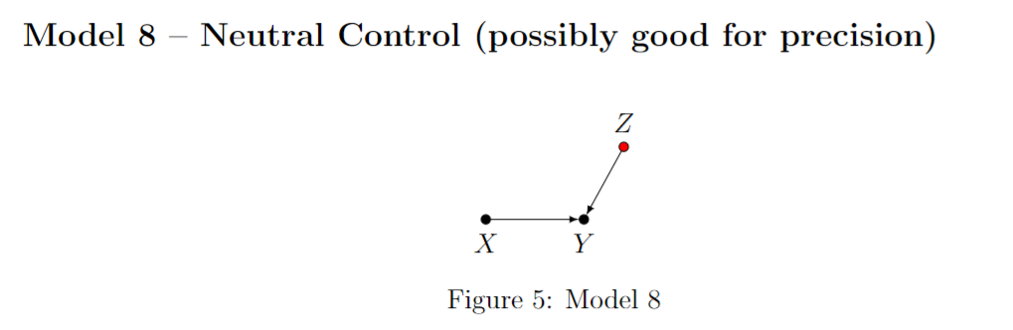
So What do I Control For (again?)
If you are doing model-based inference, your choice of controls really matters!
Notes:
What are some examples here?

Slide 41
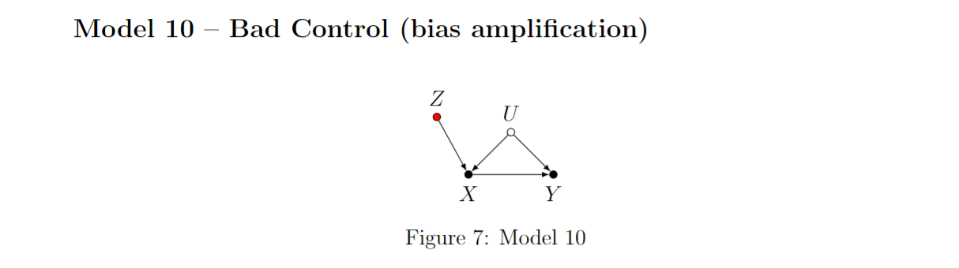
So What do I Control For (again?)
If you are doing model-based inference, your choice of controls really matters!
Notes:
What are some examples here?

Slide 42
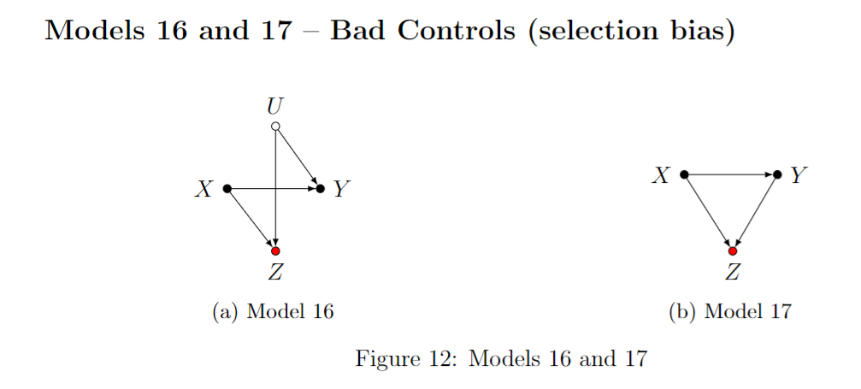
So What do I Control For (again?)
If you are doing model-based inference, your choice of controls really matters!
Notes:
The birth-weight paradox (Hern ́andez-D ́ıaz et al., 2006). Infants born to smokers were found to have higher risks of mortality than infants born to non-smokers. However, among infants with low birth-weight (LBW), this relationship was reversed. This reversal of effects has created many controversies in epidemiology—does it mean that maternal smoking is beneficial for LBW infants? A plausible reason for such a finding could simply be collider stratification bias, as shown in Model 16. Here X is maternal smoking, Y infant mortality, Z birth-weight, and U stands for unobserved risk-factors (such as birth-defects and malnutrition), that could also affect birth-weight. Note that stratifying the analysis by birth-weight would induce a spurious association between smoking and mortality due to the competing risk-factors. LBW infants of non-smokers need to have alternative causes for their LBW (such as malnutrition), and such causes could also lead to higher mortality.

Slide 43
Practical Regression Tips
Notes:
As we move into each method, I’ll try to give a “like the pros” section that talks about practical tips (coding, data structure, what goes in the paper, etc.)

Slide 44
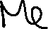





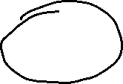
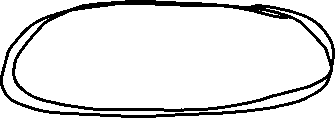
















Table 2 Fallacy
Notes:
What should you control for here? What is causal and what’s not?
A/B: if you are absolutely sure that these aren’t colliders, then control for them for precision.
C: definitely (e.g., race, education, age/sex)
W: What are possible colliders? Health behaviors, chronic conditions. Can’t control for these!
Mediators might include: investment in something like health technology?
Now for the fun part – suppose you have a regression controlling for A, B, and C (including race and education). But suppose that education is actually a collider because it is caused by health and caused by race – so beta race isn’t causal even if beta income is!

Slide 45

Reading & Constructing a Regression Table
Concise way to present multiple regressions
What should you look for when reading a table?
Key differences across models
Identify parameter authors care about
Look for changes across columns

Slide 46
Reading & Constructing a Regression Table
Concise way to present multiple regressions
What should you look for when reading a table?
Key differences across models
Identify parameter authors care about
Look for changes across columns
Other notes:
Asterisks and standard errors
Notes:
Think carefully about what type of standard errors you have. Tables should be self-contained, so that there are notes explaining what each model is, the types of Ses, etc.

Slide 47
Reading & Constructing a Regression Table
Concise way to present multiple regressions
What should you look for when reading a table?
Key differences across models
Identify parameter authors care about
Look for changes across columns
Other notes:
Asterisks and standard errors
N

Slide 48
Reading & Constructing a Regression Table
Concise way to present multiple regressions
What should you look for when reading a table?
Key differences across models
Identify parameter authors care about
Look for changes across columns
Other notes:
Asterisks and standard errors
N
Overall model performance

Slide 49
Reading & Constructing a Regression Table
Interpreting Results
Think “A 1-unit change in x…”
Economic vs. statistical significance
Causality or association?
Notes:
Note: generally don’t interpret incidental coefficients on control variables – these don’t have a causal interpretation in your approach! You wrote a regression to identify a certain causal pathway, so the parameter you get on a backdoor path isn’t the causal effect of that path (see Hunermund and Louw in Github repo).

Slide 50
Reading & Constructing a Regression Table
Interpreting Results
Think “A 1-unit change in x…”
Economic vs. statistical significance
Causality or association?
How do you make the table?

Slide 51

Reading & Constructing a Regression Table

Slide 52
Inference on Regression Coefficients
Notes:
Mention: I updated the tables/figures in the code and the slides here, so that you have some examples to work off of. PS1; next week’s class will be about data cleaning and research designs (broadly), so please come with your research questions at least half-baked, so we can talk specifics. Project proposal ideas coming up in 3 weeks.
What do you do if you don’t have a question? Read through the data dictionaries here, then do some descriptive work! And also watch the video for next week, thinking about your questions!

Slide 53


Inference: How well does our data answer our question?
$$y=β_{0}+β_{1}x_{1}+β_{2}x_{2}+ …+β_{n}x_{n}+ε$$
Any regression is left with residual variation, $ε$
Additionally, sampling variation means that if we change the data (a little), we change $\hat{β_{1}}$ (potentially a lot)
A key question of a regression model is therefore:
How certain am I that my $\hat{β_{1}}$ is telling me something informative about $β?$
Notes:
Hopefully, the law of large numbers kicks in – how do we know it does? Think back to our MC simulation from last time.

Slide 54

Inference: How well does our data answer our question?
$$y=β_{0}+β_{1}x_{1}+β_{2}x_{2}+ …+β_{n}x_{n}+ε$$
Any regression is left with residual variation, $ε$
Additionally, sampling variation means that if we change the data (a little), we change $\hat{β_{1}}$ (potentially a lot)
A key question of a regression model is therefore:
How certain am I that my $\hat{β_{1}}$ is telling me something informative about $β?$
This is the question of inference
To get there, use one of our useful assumptions (homoskedasticity):
$$𝕍\left[ε | X\right]=σ^{2}$$
Notes:
Next time, we’ll talk about what occurs if homoskedasticity is violated. This is illustrative of the simple case, but not prohibitive.

Slide 55



A Simulation Example
The intuition for inference (and standard errors, p-values, etc.) is based on simulations of a null world
Randomly shuffle the A1C checks and hospitalizations columns $↑$5,000 times, compare results for estimated $\hat{β_{1}}$
$$\hat{β_{1}}$$
Notes:
What is a null world like in our example? A1Cs don’t affect hospitalizations at all. Each simulation is a random draw of data in a null world – no effect exists.

Slide 56


A Simulation Example
The intuition for inference (and standard errors, p-values, etc.) is based on simulations of a null world
Randomly shuffle the A1C checks and hospitalizations columns $↑$5,000 times, compare results
What if this is the $\hat{β_{1}}$ our real data told us?
Notes:
If this is our estimated slope (after controlling) – this is unlikely given a bunch of random null worlds (the exact level of unlikeliness is the p-value)

Slide 57

Sampling Distribution of $\hat{β_{i}}$
$$y=β_{0}+β_{1}x_{1}+β_{2}x_{2}+ …+β_{n}x_{n}+ε$$
Under homoskedasticity, there is a nice sampling distribution for any coefficient
$$\hat{β_{i}}∼𝒩 \left(β,\frac{σ^{2}}{\sum_{\left\{i=1\right\}}^{n}{{\left(x_{i}−\overline{x}\right)}^{2}}}\right)=𝒩\left(β,\frac{σ^{2}}{SST_{x}}\right)$$
Notes:
Language here – normally distributed with a mean and variance. Note that variance diminishes with N, and that true sigma^2 is a population parameter that is unknown to us (just like true beta)

Slide 58
Sampling Distribution of $\hat{β_{i}}$
$$y=β_{0}+β_{1}x_{1}+β_{2}x_{2}+ …+β_{n}x_{n}+ε$$
Under homoskedasticity, there is a nice sampling distribution for any coefficient
$$\hat{β_{i}}∼𝒩 \left(β,\frac{σ^{2}}{\sum_{\left\{i=1\right\}}^{n}{{\left(x_{i}−\overline{x}\right)}^{2}}}\right)=𝒩\left(β,\frac{σ^{2}}{SST_{x}}\right)$$
Unbiasedness
Notes:
As our data grows, our estimate is centered around the truth – the more data, the more precise that estimate is.

Slide 59


Sampling Distribution of $\hat{β_{i}}$
$$y=β_{0}+β_{1}x_{1}+β_{2}x_{2}+ …+β_{n}x_{n}+ε$$
Under homoskedasticity, there is a nice sampling distribution for any coefficient
$$\hat{β_{i}}∼𝒩 \left(β,\frac{σ^{2}}{\sum_{\left\{i=1\right\}}^{n}{{\left(x_{i}−\overline{x}\right)}^{2}}}\right)=𝒩\left(β,\frac{σ^{2}}{SST_{x}}\right)$$
We typically estimate this variance from the regression:
$$s^{2}=\frac{\sum_{\left\{i=1\right\}}^{n}{{\hat{e}}_{i}^{2}}}{n−k−1}=\frac{SSE}{n−k−1}$$
Given our estimate of $σ^{2}$, we calculate standard errors for coefficients from the variance-covariance matrix: $s^{2}{\left(X^{′}X\right)}^{\left\{−1\right\}}$
Consistency
Notes:
As our data grows, our estimate is centered around the truth – the more data, the more precise that estimate is. We won’t go over the VCE because we don’t want to get bogged down in linear algebra, but the matrix contains estimated variance and covariance parameters for each coefficient; standard error is the square root of the diagonal.

Slide 60

Sampling Distribution of $\hat{β_{i}}$
$$y=β_{0}+β_{1}x_{1}+β_{2}x_{2}+ …+β_{n}x_{n}+ε$$
Under homoskedasticity, there is a nice sampling distribution for any coefficient
$$\hat{β_{j}}∼𝒩 \left(β,\frac{σ^{2}}{\sum_{\left\{i=1\right\}}^{n}{{\left({x_{j},}_{i}−{\overline{x}}_{j}\right)}^{2}}}\right)=𝒩\left(β,\frac{σ^{2}}{SST_{x_{j}}}\right)$$
Hence, what affects the precision of our regression coefficient?
The error variance ($↑σ^{2}⇒↑σ_{β})$
Variation in $x_{j}$ ($↑SST_{x_{j}}⇒↓σ_{β})$ – variation in $x_{j}$ is a good thing!
Size of data: since SST is summed over $n$, $Var(\hat{β_{j}})$ shrinks at $\frac{1}{n}$
Notes:
1. Is unknown

Slide 61

Standard Errors
$$y=β_{0}+β_{1}D+β_{2}X+ε$$
The standard deviation of an estimator is referred to as a standard error
Standard errors allow you to use what you observe in a regression to test hypotheses about the (unobserved) data generating process

Slide 62

Hypothesis Testing
$$y=β_{0}+β_{1}D+β_{2}X+ε$$
Example: We care about the effect of $D$ on $Y$ after controlling for $X$.
Can we say that $β_{1}≠0$?

Slide 63

Hypothesis Testing
$$y=β_{0}+β_{1}D+β_{2}X+ε$$
Example: We care about the effect of $D$ on $Y$ after controlling for $X$.
Can we say that $β_{1}≠0$?
Null hypothesis: $ℋ_{0}:β_{1}=0$ (the typical null hypothesis)
Alternative hypothesis: $ℋ_{A}:β_{1}≠0$
Rejection value: $α$ (typically 0.05)
Notes:
The null hypothesis is our simulated world.

Slide 64

Statistical Tests on Coefficients
$$y=β_{0}+β_{1}D+β_{2}X+ε$$
Statistical tests tell you something about if a supposed distribution for a parameter is unlikely
Related calculations:
p-value: the exact percentile of our statistic
T-statistic: standardized way of representing the percentile (standard normal)
$$t_{i}=\frac{\hat{β_{i}}}{se(\hat{β_{i}})}$$
How are these related to $α?$

Slide 65

Statistical Significance
Notes:
We’ll talk more about this in a minute after regression tables.

Slide 66
Types of Significance
What does significance mean?
Something that isn’t significant isn’t wrong – just insignificant
Precise nulls are of research interest
A model should never be modified ex-post to obtain significant results!
One test is rarely sufficient to come to a conclusion
This is why economics papers are typically 50+ pages plus appendix
Notes:
New thing to hit here: economic versus statistical significance – a p-value is all well and good, but what is the takeaway? What’s the story?

Slide 67
Types of Significance
What does significance mean?
Something that isn’t significant isn’t wrong – just insignificant
Precise nulls are of research interest
A model should never be modified ex-post to obtain significant results!
One test is rarely sufficient to come to a conclusion
This is why economics papers are typically 50+ pages plus appendix
Difference between statistical significance and economic significance
What does your result mean?
What does it mean to be statistically significant in this context?
What does the estimated coefficient imply about policy? Welfare? Etc.?
Notes:
New thing to hit here: economic versus statistical significance – a p-value is all well and good, but what is the takeaway? What’s the story?

Slide 68
What do my results mean?
Types of causal validity
Notes:
We’re gonna talk about some types of “causal validity” – not R-squared but when the link between regression and model is strong enough.

Slide 69

What do my results mean?
Types of causal validity
Construct validity: are we measuring what we want to measure?
How is the outcome variable measured?
Are we capturing the right spot in the distribution (mean, median, etc.?)
Notes:
This is also known as the street light effect – researchers shine the light just on the street, miss what’s to the side. Are you asking the right questions? An example: a program hopes to improve commitment to school, and boasts that it improves test scores -- does that measure the outcome you want (teacher performance, kid happiness, etc.?) or does it just measure how good kids are at taking tests. Data limitations play a big role here (in health, think quality measurements, or metrics of risk/equity/etc.)

Slide 70
What do my results mean?
Types of causal validity
Construct validity: are we measuring what we want to measure?
Notes:
There are example papers of these in the github repo

Slide 71
What do my results mean?
Types of causal validity
Construct validity: are we measuring what we want to measure?
Statistical validity: are your statistics correct?
Do you have enough statistical power to get the results that you want?
Are all of your required assumptions met?
Was there any p-hacking involved in getting the answer you published?
Are your associations causal or spurious correlation?
Notes:
These are questions that are nearly impossible to answer in a paper or project (okay, you can do a power calculation – ish). But you still need to think carefully about each of these.

Slide 72

Statistical Power
Notes:
If you sample a small group repeatedly, you get a lot of different answers. But if you sample a large group even fewer times, your effects are more noticeable. Power calculations can tell you something about what the sample size should be (going out the window with big data)

Slide 73

How do I report my results and assumptions?
The TRIPOD Checklist has useful structure on what you should be watching out for
Notes:
Also includes things like – what limitations should be noted, what should go in a discussion, etc. We’ll try to talk more about this with each method we cover.

Slide 74

Are my results hacked? Are they spurious?
Notes:
For p-hacking, remember the website: https://projects.fivethirtyeight.com/p-hacking/. Did you correct for multiple testing? Did you perform 20 tests and report the one significant result?

Slide 75

Aggregate p-hacking: Publication Bias
Notes:
Distribution of p-values in research – what does this tell you? (Note that the z-stat is the test statistic, the inverse of the p-value)

Slide 76
What do my results mean?
Types of causal validity
Construct validity: are we measuring what we want to measure?
Statistical validity: are your statistics correct?
Internal validity: are your mechanisms correct?
Did you pick up the causal pathway you wanted?
Lots of threats!
Selection, omitted variable bias, attrition, seasonality, measurement error, spillovers
Each of these can affect your results
Notes:
Economists call internal validity “identification” You might not even have seen all the threats if your DAG is incomplete or wrong. A good econometrician is trained to try to pick at all the potential threats to identification / internal validity here. The best way to get around these is to think about as many as you can and then present your work as much as you can – people will help you see what you’re missing.

Slide 77

Example of Selection Bias: Marriage and Happiness
Notes:
Cover this example if you have time.

Slide 78

Example of Selection Bias: Marriage and Happiness
Notes:
Cover this example if you have time. Comparison between age of marriage and reported happiness (note: think about construct validity here too, with happiness scores). The selection is those choosing to be married in time sample, but could there be other threats?

Slide 79

Example of Selection Bias: Marriage and Happiness
Notes:
What threats are there to this (selection into early marriage, etc.)

Slide 80

Example of Selection Bias: Marriage and Happiness
Notes:
The authors tried to compare based on relative years around marriage, but look: happiness ticks up before marriage – so it can’t be from marriage! Of course, there are problems with this design (end of semester).
We will talk about more internal validity threats next time as well.

Slide 81
What do my results mean?
Types of causal validity
Construct validity: are we measuring what we want to measure?
Statistical validity: are your statistics correct?
Internal validity: are your mechanisms correct?
External validity: are your findings generalizable?
Are your results a fluke of a limited sample?
Notes:
We’ll talk about more threats to internal validity throughout the course, particularly next time. If you want to think about multiple threats to IV, just think about nutrition research (they’re everywhere!)

Slide 82

Example of External Validity
Notes:
Um what? Don’t trust the headlines, or the lay media.

Slide 83

Example of Selection Bias: Marriage and Happiness
Notes:
True story: this was a study published about mice! But read the text summarizing the study.

Slide 84

What do my results mean?
Types of causal validity
Construct validity: are we measuring what we want to measure?
Statistical validity: are your statistics correct?
Internal validity: are your mechanisms correct?
External validity: are your findings generalizable?
Are your results a fluke of a limited sample?
Does your data match the population?
Notes:
Particularly of concern with surveys or even clinical trials

Slide 85
Summary
Regression is a very powerful tool (use it well)
Importance of controlling for colliders/covariates
Inference and uncertainty of a regression
Interpreting regression coefficients and tables
Presenting your results
Next time: getting fancier with regression
Types of variables you can use
Interaction effects
(Some) Nonlinear models

